Slide 1
Ignite the spark, reveal the champion
17th September 2024
Supporting Year 3 Children
Parent Workshop
Hosted by
Miss Kelly, Ms Scotland and Ms Mensah,

Slide 2
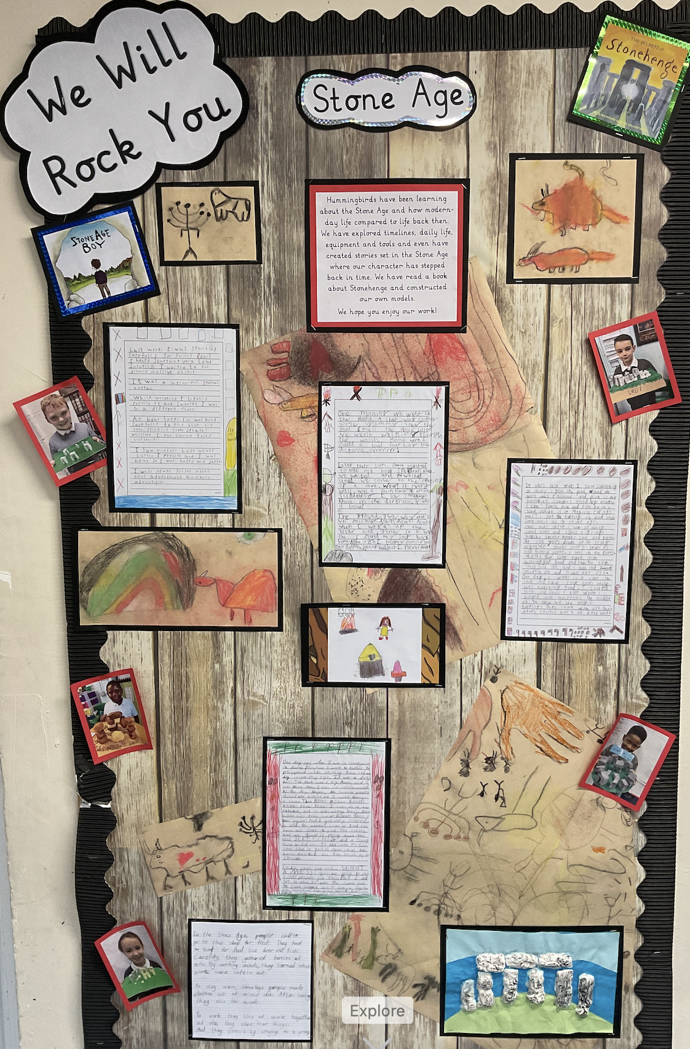
Gratitude
"Thank you for your invaluable support throughout your child’s start of their Year 3 journey. Your partnership has made a lasting impact on their learning and growth."
Notes:
Mention seamless transition
Chn have been settled
Three classes have all had a successful start. Add pictures of the class outside displays here

Slide 3
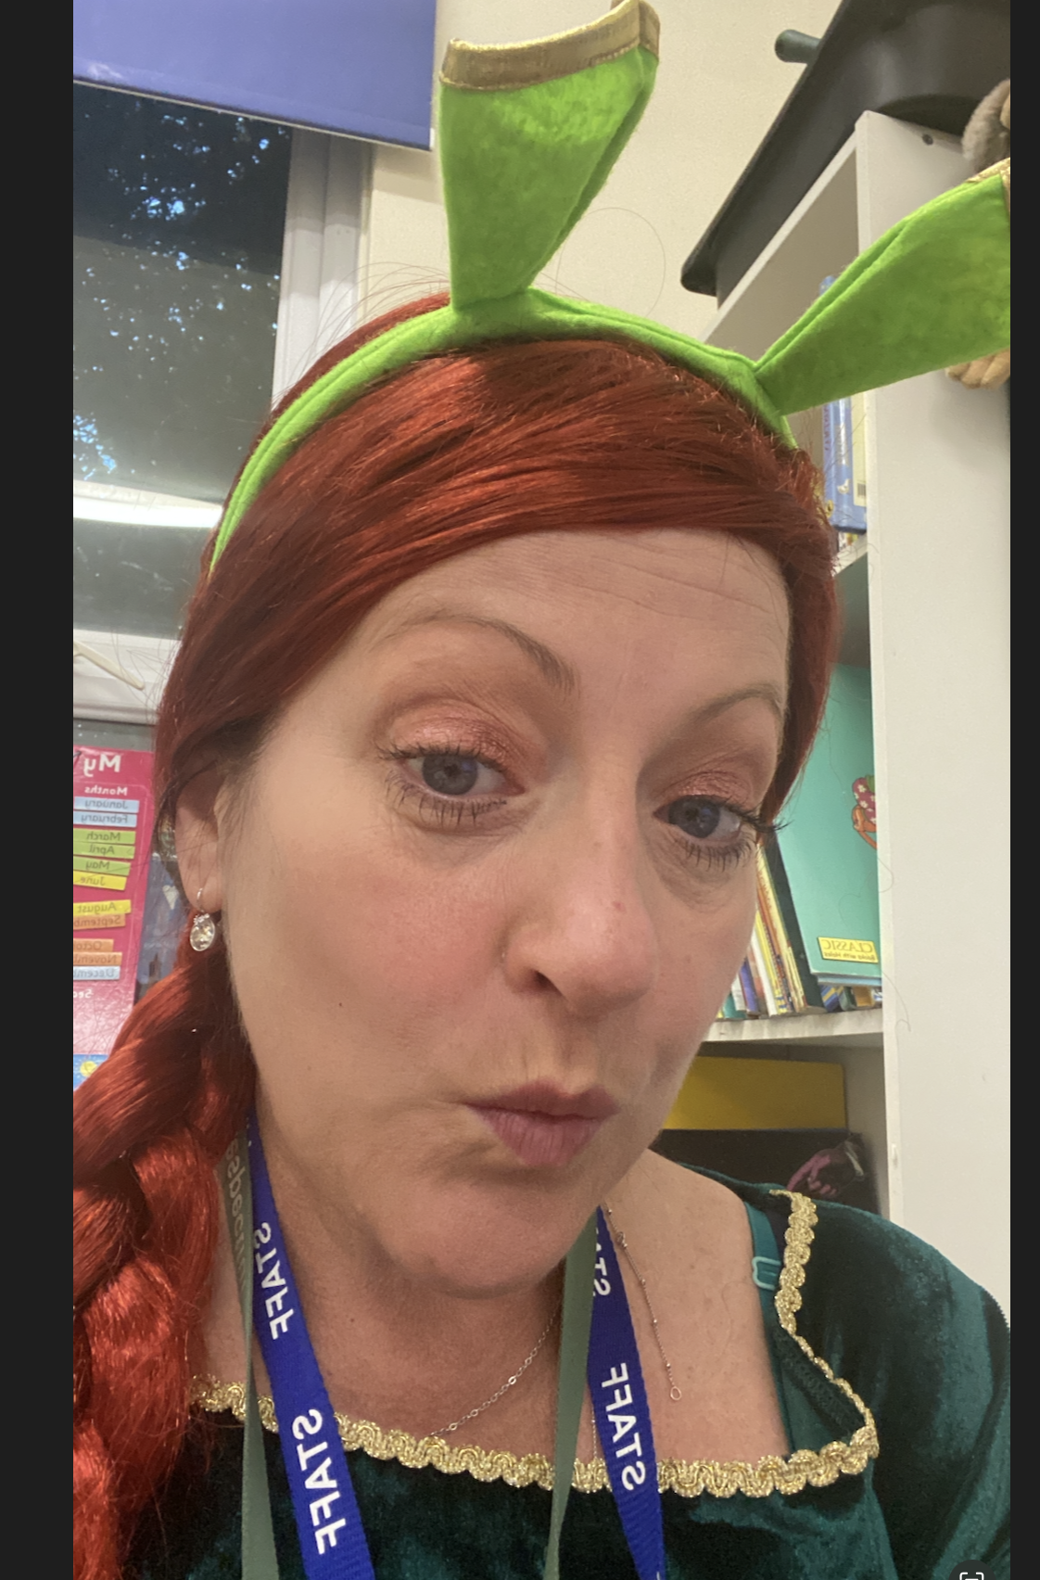
Meet the team!
Miss Kelly
Robins Class
Ms Scotland
Kingfishers Class
Ms Mensah
Hummingbirds class

Slide 4
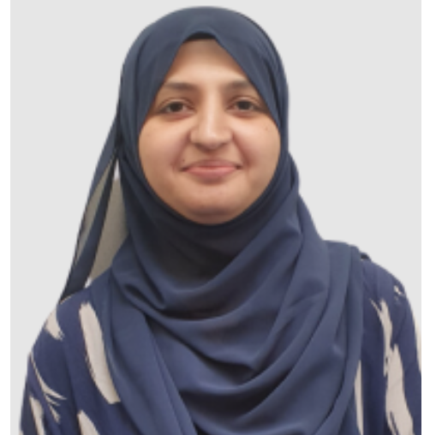
Meet the team!
Mrs Mudassar
Robins Class TA
Mrs Hrdlicka
Kingfisher Class TA
Mrs Aylwin
Hummingbirds Class TA

Slide 5
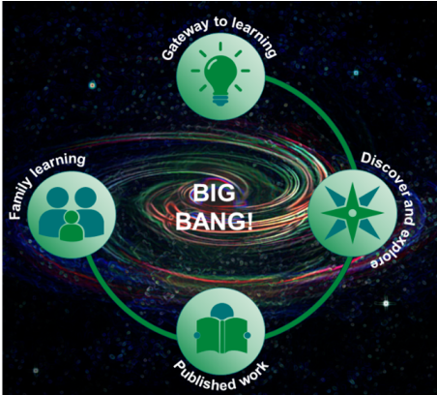
Learning in Year 3 - Topics
Autumn 1 | Autumn 2 | Spring 1 | Spring 2 | Summer 1 | Summer 2
We Will Rock You! Stone Age boy | I Need a Hero! The Iron Man | Disaster! The Boy who Lost his spark | Ruthless Romans Visionary Escape from Victorians Pompeii Arthur Who Wrote Sherlock |  | Viva Espana Toro Toro
Core Texts as Topic Leaders
Sequential and Iterative Curriculum
Local & Global Perspectives
Engaging & Adaptive Teaching
Big Bangs & Family Learning Afternoons
Notes:
Each topic is driven by high-quality core texts that link subjects together. This approach helps children make meaningful connections across subjects, deepening their understanding and engagement.
Is carefully mapped out to ensure learning is progressive and builds on previous knowledge. By reinforcing learning with trips, visitors, and special events like Big Bang Days, children develop contextual and purposeful links throughout their primary education.
The curriculum emphasises learning about the local area of Greenhithe, its history, and its geographical importance, while also encouraging students to understand how their community connects to London, the wider UK, and the world.
We develop medium- and short-term plans that are engaging, ambitious, and inclusive. The curriculum uses a universal design for learning approach, incorporating adaptive strategies to meet the needs of all students.
Each topic begins with a 'Big Bang' event to spark curiosity and ends with a Family Learning Afternoon, where students share their work. The children's own perspectives on what they want to learn (gathered through 'gateway to learning') guide part of the topic, ensuring that their interests are reflected in the learning process.

Slide 6
Learning in Year 3 - Literacy
Reading Schemes and Whole-Class Reading
Reading for Pleasure
Writing
Oracy, Vocabulary, and EGPS (English, Grammar, Punctuation, Spelling)
Notes:
Children develop foundational literacy through the systematic Little Wandle Letters & Sounds approach. Phonics knowledge is used as the primary method to decode words, complemented by language comprehension.
Once phonics is mastered, children transition to high-quality texts that encompass a variety of literature types. These books support learning in subjects like geography, science, and history, with an emphasis on content from the National Curriculum.
We foster a love of reading by providing well-resourced libraries and book corners, aiming to create a community of readers. This includes an emphasis on reading for enjoyment and developing a lifelong reading habit.
The writing curriculum is closely linked to core texts, providing opportunities to write for different purposes. Children are taught to craft sophisticated sentences and apply quality vocabulary in extended writing tasks, preparing them for the world beyond primary school.
Speaking skills are emphasized through structured opportunities to speak clearly and confidently. Vocabulary development is actively pursued in all subjects, and children follow a bespoke Grammar, Punctuation, and Spelling (EGPS) curriculum to enhance their written communication skills.

Slide 7
Learning in Year 3 - Literacy
Reading Plus
Notes:
Children develop foundational literacy through the systematic Little Wandle Letters & Sounds approach. Phonics knowledge is used as the primary method to decode words, complemented by language comprehension.
Once phonics is mastered, children transition to high-quality texts that encompass a variety of literature types. These books support learning in subjects like geography, science, and history, with an emphasis on content from the National Curriculum.
We foster a love of reading by providing well-resourced libraries and book corners, aiming to create a community of readers. This includes an emphasis on reading for enjoyment and developing a lifelong reading habit.
The writing curriculum is closely linked to core texts, providing opportunities to write for different purposes. Children are taught to craft sophisticated sentences and apply quality vocabulary in extended writing tasks, preparing them for the world beyond primary school.
Speaking skills are emphasized through structured opportunities to speak clearly and confidently. Vocabulary development is actively pursued in all subjects, and children follow a bespoke Grammar, Punctuation, and Spelling (EGPS) curriculum to enhance their written communication skills.

Slide 8
Learning in Year 3 - Mathematics
Mastery Approach to Maths
Coherence
Representation & Structure
Fluency & Variation
Encouraging Mathematical Thinking
Reasoning and problem solving
Notes:
we aim to develop deep, secure, and adaptable understanding in maths, using the White Rose Maths framework. Mastering maths means that students can apply their learning in various contexts and develop problem-solving skills.
Lessons are broken into small, connected steps to build progressively, allowing all children to grasp concepts and apply them in a range of scenarios. This structured approach supports both conceptual understanding and application.
We use concrete resources and visual representations (pictorials) to help children make abstract mathematical concepts more tangible. For instance, using objects like apples for counting or shapes for fractions helps bridge the gap between concrete and abstract thinking.
Fluency in basic maths facts (such as number bonds and times tables) is reinforced through daily 'maths meets.' Teachers also vary the presentation of mathematical ideas to help children understand concepts from multiple perspectives, focusing on the relationships and structure in maths (e.g., if 2 + 2 = 4, then 12 + 2 = ?).
Teachers model precise maths language and encourage students to share and discuss their thinking. Questioning is key to deepening understanding by exploring how children arrive at solutions and making connections between mathematical ideas.

Slide 9
Learning in Year 3 - Science
Progressive Science Curriculum
Practical Scientific Enquiry
Integration Across Subjects
Scientific Vocabulary and Communication
Scientific Enquiry Skills & Everyday Application
Notes:
is designed to foster exploration and discovery in biology, chemistry, and physics. Pupils build foundational knowledge and concepts, developing skills in scientific thinking, rational explanation, and curiosity about natural phenomena.
Children are encouraged to engage in hands-on activities where they collect data, make observations, and draw conclusions. They use technology (e.g., iPads, graphs, and diagrams) to systematically record and present findings, helping them justify their ideas and develop deeper understanding.
Science learning is integrated into other subjects, such as communication and language development, literacy, and mathematics. For example, children practice using scientific vocabulary, apply their maths skills to count and estimate in investigations, and explore the natural world through creative arts.
Emphasis is placed on learning and using accurate scientific vocabulary. Children are encouraged to discuss scientific concepts using relevant terminology, describe processes, and understand how scientific ideas have evolved over time.
Children learn to plan and conduct different types of scientific enquiries (e.g., fair tests, pattern recognition, classification). They are taught to recognise how science impacts daily life, explore the benefits and drawbacks of scientific development, and apply their understanding to real-world contexts.

Slide 10
Day-to-Day
 | Robins | Kingfishers | Hummingbirds
PE Days | Monday & Tuesday | Tuesday & Thursday | Tuesday & Friday
PE uniform | Black shorts White round necked T-shirt with or without school emblem Plimsolls for indoor PE & trainers for outdoor PE Black tracksuits may be worn outside in Winter
Reading record | Brought in daily with a comment.
Homework | Topic work 6-times a year, 20-minutes reading daily, TTRS & Reading Plus 3xweek for 10-mins, Magma Maths 1 x fortnight
Notes:
Have handout prepared and on seats.

Slide 11
Helping from Home
Maths
Magma Maths and TTR
CGP books
Writing
Descriptosaurus
Explore the meaning of words
Reading
Asking questions about the texts
Take turns to read together with your child
Ideas: https://www.booktrust.org.uk/books-and-reading/tips-and-advice/reading-tips/

Slide 12
Supporting your child during Year 3!
Firstly, a positive attitude goes a long way. Give them as much encouragement and support as you can (but we don’t need to tell you that)!
Tips:
Read every day and ask questions about the book.
Practise Times tables daily
Talk to your child’s class teacher if you have any concerns rather than worry your child.
Encourage your child to talk to their teacher or a trusted adult (including yourself) about their anxieties. Don’t forget that a small amount of anxiety is normal and not harmful.
Give your child a quiet, distraction free space to complete homework or study.
Give your child time to go outside and reduce screen time.
Ensure your child is eating and drinking well and getting a good amount of sleep.

Slide 13
We Welcome Your Feedback!
Class teacher
Mr Forrest (Phase Lead)
Mrs Wady (DHTI) / Mrs Riley (DHTC)
Miss Yiannadji (Headteacher)
Notes:
Mention writing

Slide 14
Questions?

Slide 15
Thank you!

