Slide 1
Ignite the spark, reveal the champion
17th September 2024
Supporting Year 6 Children
Parent Workshop
Hosted by
Mrs Moss, Miss Allen & Mrs Lloyd

Slide 2
Gratitude
"Thank you for your invaluable support throughout your child's Year 5 journey.
Your partnership has made a lasting impact on their learning and growth."

Slide 3
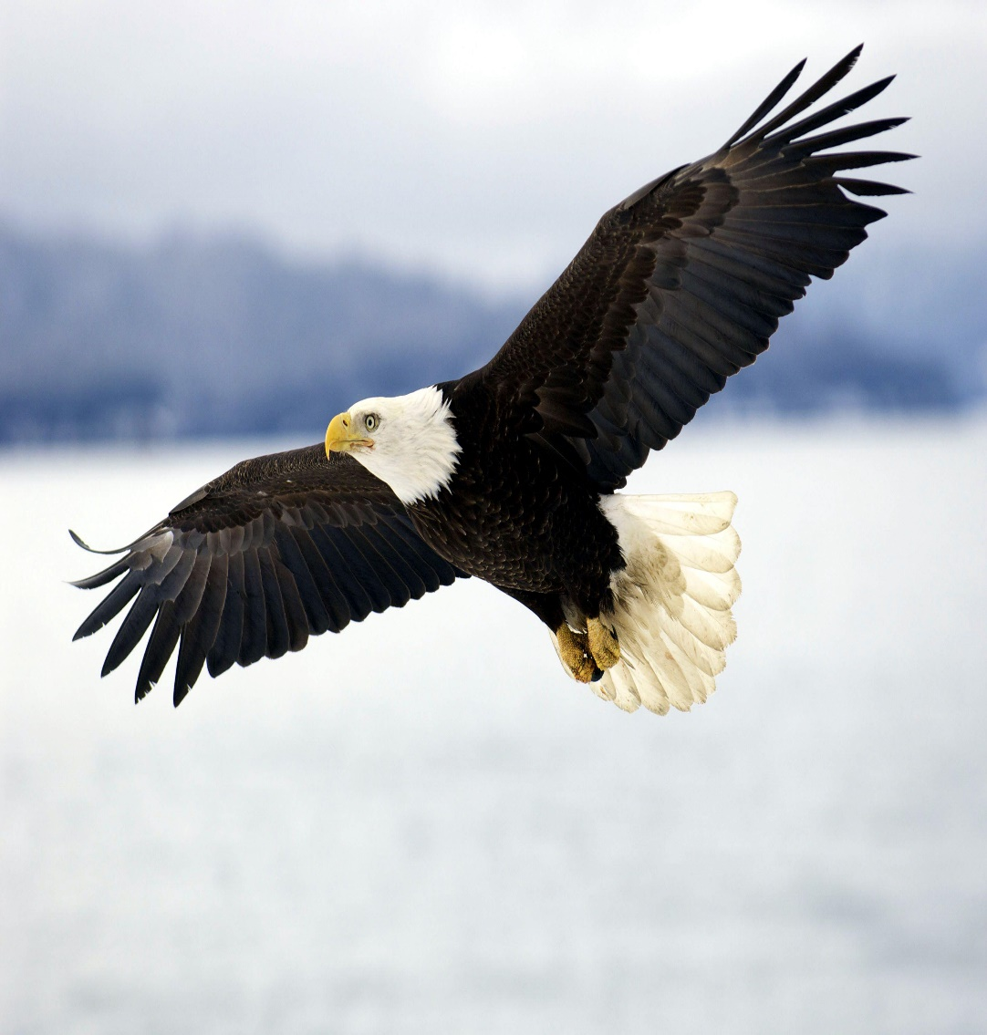
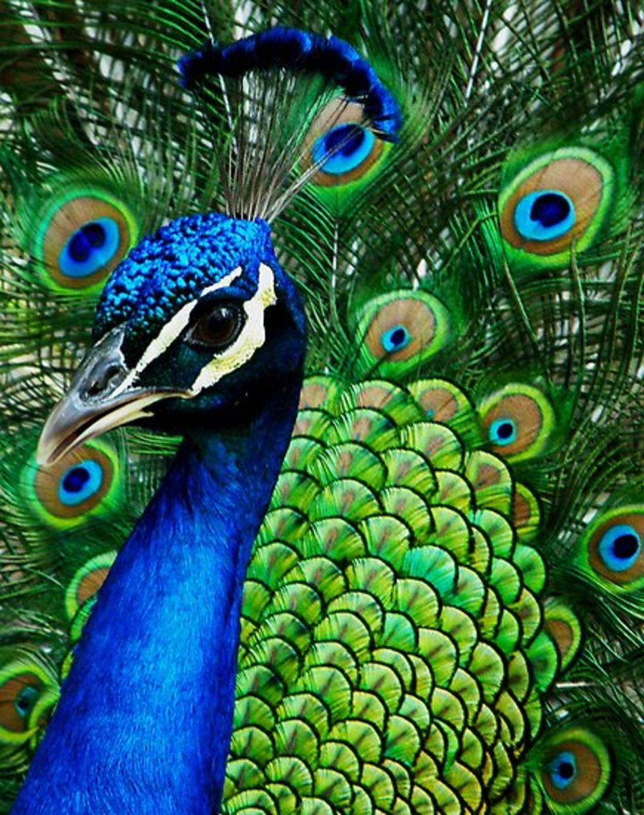
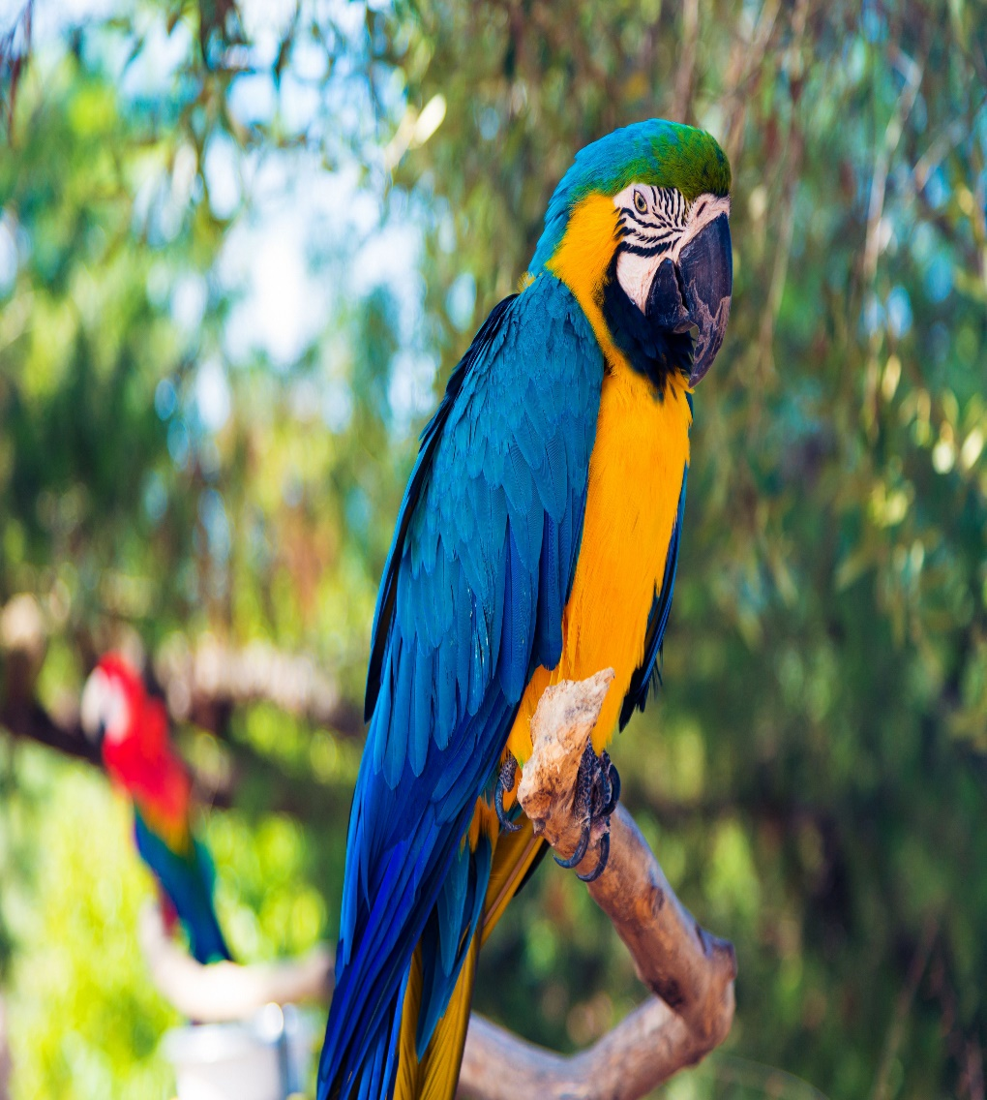
Meet the team!
Mrs Moss
Eagles Class
USK2 lead
Miss Allen
Peacocks Class
Assistant Headteacher
Mrs Lloyd
Parrots Class

Slide 4
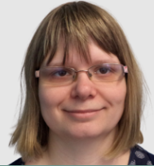
Meet the team!
Miss Marshall
Year 5/6 TA

Slide 5
Attendance & Lateness
Regular attendance ensures children stay on track with learning, while absences or lateness lead to missed opportunities and knowledge gaps.
Consistent attendance fosters a strong sense of belonging and helps children build confidence and positive relationships.
Good attendance directly correlates with higher academic achievement and better social development, setting the stage for future success.

Slide 6
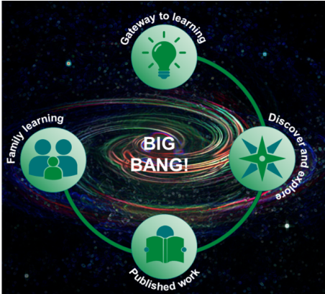
Learning in Year 6 - Topics
Autumn 1 | Autumn 2 | Spring 1 | Spring 2 | Summer 1 | Summer 2
Stand and Deliver | Friend or Foe | Rule of Law | Survival of the fittest |  | Migration
Core Texts as Topic Leaders
Sequential and Iterative Curriculum
Local & Global Perspectives
Engaging & Adaptive Teaching
Big Bangs & Family Learning Afternoons

Slide 7
Learning in Year 6 - Literacy
Phonics & Early Reading
Reading Schemes and Whole-Class Reading
Reading for Pleasure
Writing
Oracy, Vocabulary, and EGPS (English, Grammar, Punctuation, Spelling)

Slide 8
Learning in Year 6 - Mathematics
Mastery Approach to Maths
Coherence
Representation & Structure
Fluency & Variation
Encouraging Mathematical Thinking

Slide 9
Learning in Year 6 - Science
Progressive Science Curriculum
Practical Scientific Enquiry
Integration Across Subjects
Scientific Vocabulary and Communication
Scientific Enquiry Skills & Everyday Application

Slide 10
Day-to-Day
 | Peacocks | Eagles | Parrots
PE Days | Wednesday & Friday | Monday & Thursday | Monday &Thursday
PE uniform | Black shorts White round necked T-shirt with or without school emblem Plimsolls for indoor PE & trainers for outdoor PE Black tracksuits may be worn outside in Winter
Reading record | Brought in daily with a comment.
Homework | Topic work 6-times a year, 20-minutes reading daily, TTRS & Reading Plus 3xweek for 10-mins, Magma Maths 1 x fortnight

Slide 11
Helping from Home
Maths
White Rose Maths
CGP books
Writing
Descriptosaurus
Explore the meaning of words
Reading
Asking questions about the texts
Take turns to read together with your child
Ideas: https://www.booktrust.org.uk/books-and-reading/tips-and-advice/reading-tips/

Slide 12
SATs
Statutory Assessment Tests
Timetabled from Monday 12th May to Thursday 15th May 2025
Date | Exam
Monday 12th May 2025 | Grammar, Punctuation & Spelling - Paper 1 Grammar, Punctuation & Spelling - Paper 2
Tuesday 13th May 2024 | English Reading
Wednesday 14th May 2024 | Maths Paper 1 (Arithmetic) Maths Paper 2 (Reasoning)
Thursday 15th May 2024 | Maths Paper 3 (Reasoning)
We will be holding information sessions specifically about SATs in March and May.

Slide 13
Supporting your child during Year 6!
Firstly, a positive attitude goes a long way. Give them as much encouragement and support as you can (but we don’t need to tell you that)!
Tips:
Don’t use past papers as they are used in school to prepare the children.
Attend SATs meetings at school (or read any literature sent home).
Talk to your child’s class teacher if you have any concerns rather than worry your child.
Encourage your child to talk to their teacher or a trusted adult (including yourself) about their anxieties. Don’t forget that a small amount of anxiety is normal and not harmful.
Give your child a quiet, distraction free space to complete homework or study.
Give your child time to go outside and reduce screen time.
Ensure your child is eating and drinking well and getting a good amount of sleep.
Plan something nice and fun for the weekends before and after SATs. This will help them to relax before the SATs and give them something to look forward to after.

Slide 14
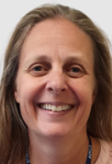
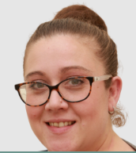
We Welcome Your Feedback!
Class teacher
Mrs Moss (Phase Lead)
Mrs Wady (DHTI) / Mrs Riley (DHTC)
Miss Yiannadji (Headteacher)

Slide 15
Experiences post-SATs?
Swimming (Term 6)
Leaver’s Assembly / Prom
Residential Trip
Sports Day
Enterprise Week
Creative Workshops
Add text

Slide 16
Questions?

Slide 17
Thank you!
Mrs Moss
Eagles Class
USK2 lead
Miss Allen
Peacocks Class
Assistant Headteacher
Mrs Lloyd
Parrots Class

